Slide 1









Student
Management
System

Slide 2





Introduction
The C program for managing student records in a school. It includes functions to add, search, delete, update, and display student records. The program uses a file "schoolRecord.txt" to store the student information. It also uses a structure "stulnfo" to define the format of the student record

Slide 3




Project overview
·The program starts with the main function, which presents a menu to the user and allows them to choose from various options such as adding a student record, searching for a student record, deleting a student record, updating a student record, showing all student records, and exiting the program.

Slide 4


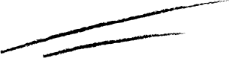

Objectives

Slide 5


Objectives
1
2
3
The "addStudentRecord" function is used to add a new student record to the file. It prompts the user to enter the student's name, class, age, gender, and admission date. It then appends the new record to the file.
The"searchStudentRecord" function allows the user to search for a student record based on the student's ID number. It reads the file and compares the entered ID number with the ID numbers in the file to find a match
The "deleteStudentRecord" function enables the user to delete a student record based on the student's ID number. It reads the file, creates a temporary file, and copies all records except the one to be deleted to the temporary file. Then it replaces the original file with the temporary file

Slide 6
Objectives
4
5
6
The"updateStudentRecord" function provides the user with options to update a student's name, class, or age based on the student's ID number. It reads the file, makes the necessary changes, and updates the file with the modified record.
The"showAllStudentRecord" function displays all student records in the file. It also provides an option to display records for a specific class
The program runs in a loop until the user chooses to exit.

Slide 7


System Requirement
Software Requirements
Operating System: - Microsoft Windows XP or above.
Software used : - Dev-C++ [MSC v.192532 or 64 bit (Intel)]on window 32 or 64 bits RAM.

Slide 8

System Requirement
2. Hardware requireds
Processor: - Intel Pentium 4 or Above
Hard Disk: - 64GB or more
RAM: - 1GB or more
Printer: - Any.
Monitor: - SVGA Color Monitor (Touch Screen or Simple).
Pointing Device: - Touch Pad or Keys.

Slide 9

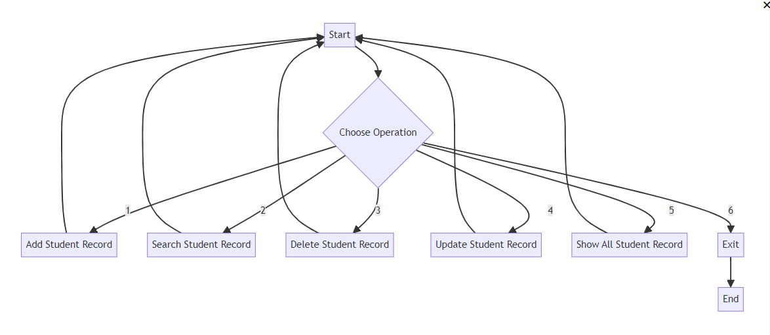
Flowchart

Slide 10


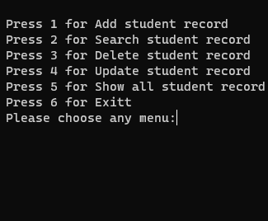
Output
fig 1 Menu

Slide 11
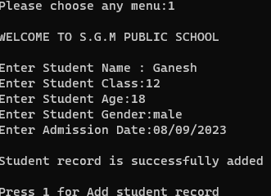
Output
fig 1 Add Student

Slide 12
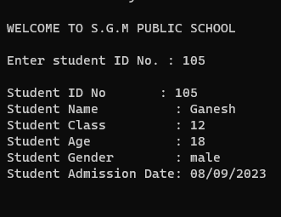
Output
Fig:2 Search

Slide 13
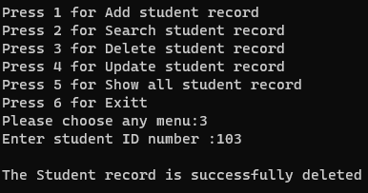
Output
Option 3:- Delete

Slide 14
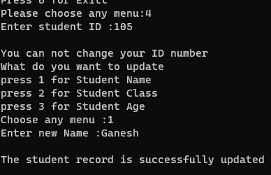
output
Option 4:- Update

Slide 15
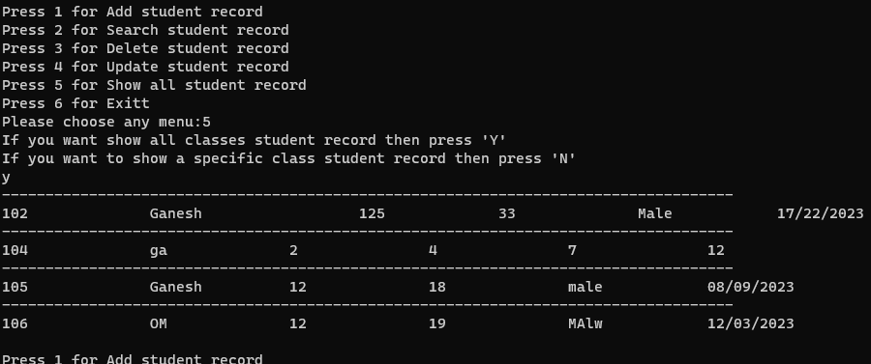
Output
option 5:- Show All

Slide 16





Technology used
C is a general-purpose programming language created by Dennis Ritchie at the Bell Laboratories in 1972. It is a very popular language, despite being old. The main reason for its popularity is because it is a fundamental language in the field of computer science. It is essential to have a background in computer memory mechanisms because it is an important aspect when dealing with the C programming language.

Slide 17
Technology used
Applications of C Language
• Development of video games
• Applications using graphical user interfaces
• Databases and computer operating systems
• Browsers on the internet.
• Computational and graphical methods.

Slide 18
SCOPE OF THE PROJECT
At present such systems are accepted by many educational institutions such as universities and the main objective is to facilitate the work efficiently and modernize the use of such a system based on smart technology. When we create this system, we used better techniques for a get high output. For an example we used Database Tigger function for thissystem.

Slide 19




Future Implementation
The Registration Department, IT Division, Examination Department, Library Management ,IDs and Administration Department. The system created above provides a good connection for all these areas.All you'll need is a user ID and a password to get started. We hope to make this interface even more attractive. Simply put, the idea here is to prove authenticity. (v. Forrester, 2019) We hope to include some more important icons for these interfaces as well.

Slide 20
Conclusion
This system is described in detail as a student management system, a system that assists educational institutions such as universities in managing student information and all relevant data properly. The main objective is to manage the relevant systems through a well-designed and computerized system for all aspects such as All students have their own smart ID.

Slide 21


THANK YOU

